Slide 1
Binary Classification and Performance Measures

Slide 2
Performance Measures

Slide 3
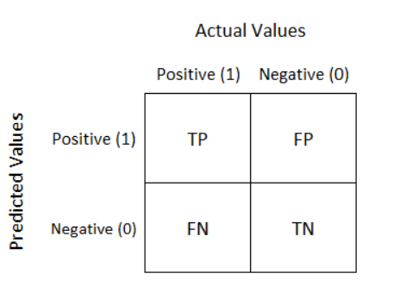
Confusion Matrix
A confusion matrix is a performance measurement technique for Machine learning classification.
It is an N x N matrix used for evaluating the performance of a classification model, where N is the number of target classes.
For a binary classification problem, it is a two-by-two table that contains four outcomes produced by a binary classifier.

Slide 4
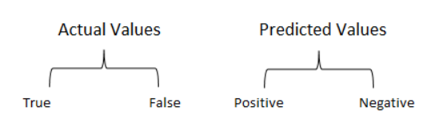
Confusion Matrix
True Positive(TP):
Interpretation: You predicted positive and it’s true.
You had predicted that France would win the world cup, and it won.
True Negative(TN):
Interpretation: You predicted negative and it’s true.
You had predicted that England would not win, and it lost.
False Positive(FP): (Type 1 Error)
Interpretation: You predicted positive and it’s false.
You had predicted that England would win, but it lost.
False Negative(FN): (Type 2 Error)
Interpretation: You predicted negative and it’s false.
You had predicted that France would not win, but it won.
Just Remember, We describe predicted values as Positive and Negative and actual values as True and False.

Slide 5
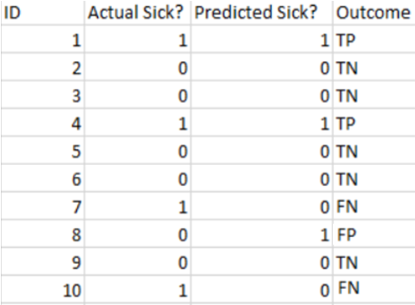
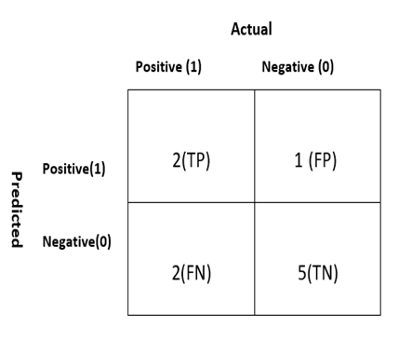
Example 1
Total
3
7
Total
4
6
10

Slide 6
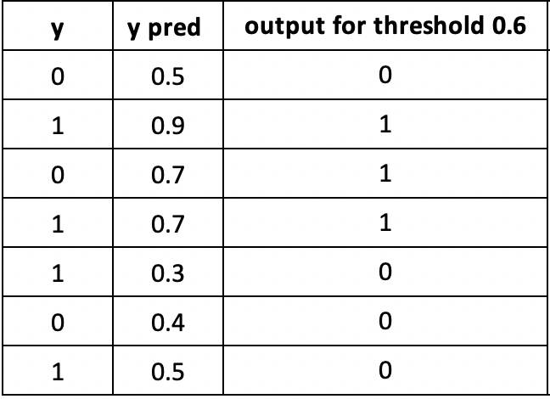
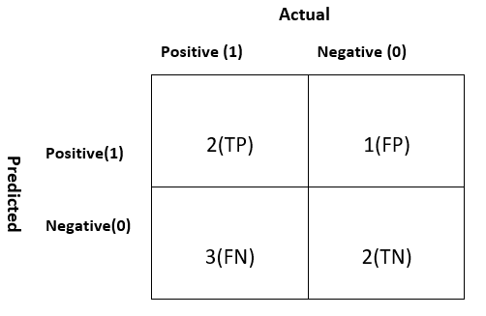
Example 2
TN
TP
FP
TP
FN
TN
FN

Slide 7
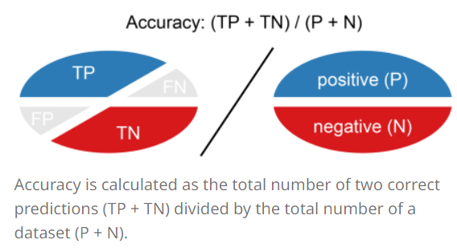
Accuracy
Accuracy (ACC) is calculated as the number of all correct predictions divided by the total number of the dataset.
The best accuracy is 1.0, whereas the worst is 0.0.
Overall, how often is the classifier correct?

Slide 8

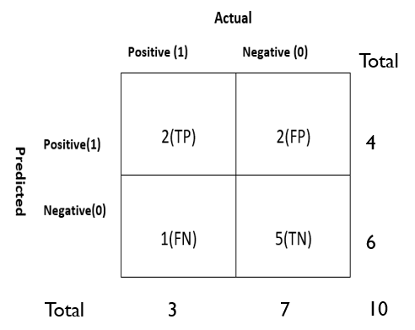
Accuracy(cont)
The accuracy would be calculated by the following formula
ACC= (2+5)/10 = 0.7
So the model is saying I can predict sick people 70% of the time.

Slide 9
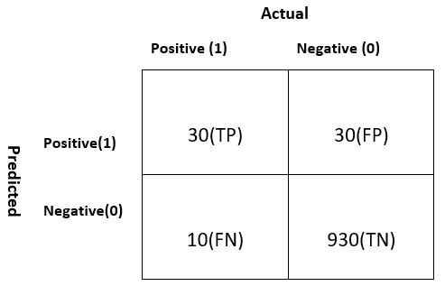
ACCURACY(cont)
Let’s take another example.
Total
ACC=(TP+TN)/P+N = (30+930)/1000 = 0.96
60
Our model is saying “I can predict sick people 96% of the time”.
940
Total
40
960
1000
Notes:
However, it is doing the opposite. It is predicting the people who will not get sick with 96% accuracy while the sick are spreading the virus! Do you think this is a correct metric for our model given the seriousness of the issue? Shouldn’t we be measuring how many positive cases we can predict correctly to arrest the spread of the contagious virus? Or maybe, out of the correctly predicted cases, how many are positive cases to check the reliability of our model?
This is where we come across the dual concept of Precision and Recall.

Slide 10
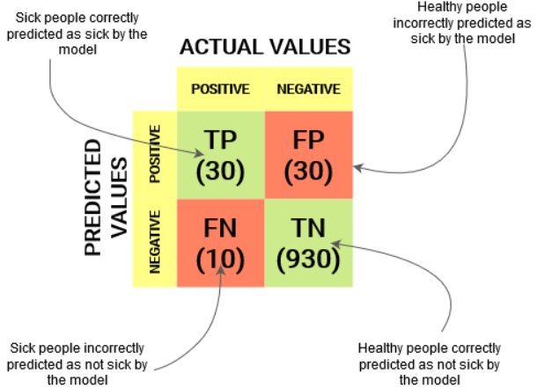
Confusion Matrix

Slide 11
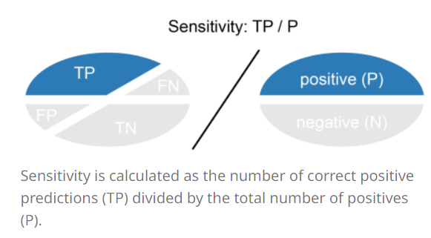
Recall
Recall (REC) is calculated as the number of correct positive predictions divided by the total number of positives.
It is also called sensitivity (SN) or true positive rate (TPR).
The best recall is 1.0, where as the worst is 0.0.
Recall tells us how many of the actual positive cases we were able to predict correctly with our model.

Slide 12
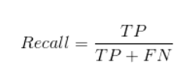
Recall(CONT)
The recall would be calculated by the following formula
Total
60
REC= 30/(30+10) = 0.75
940
75% of the positives were successfully predicted by our model. Awesome!
Total
40
960
1000
Notes:
Recall is a useful metric in cases where False Negative trumps False Positive.
Recall is important in medical cases where it doesn’t matter whether we raise a false alarm but the actual positive cases should not go undetected!
In our example, Recall would be a better metric because we don’t want to accidentally discharge an infected person and let them mix with the healthy population thereby spreading the contagious virus. Now you can understand why accuracy was a bad metric for our model.

Slide 13
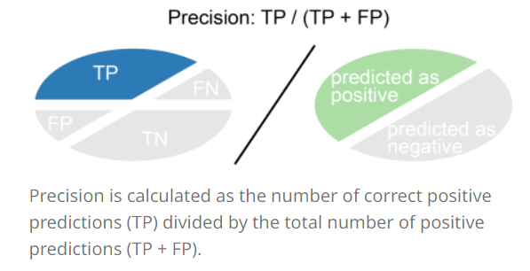
Precision
Precision (PREC) is calculated as the number of correct positive predictions divided by the total number of positive predictions.
It is also called positive predictive value (PPV).
The best precision is 1.0, whereas the worst is 0.0.
Precision tells us how many of the correctly predicted cases actually turned out to be positive.

Slide 14

Precision(cont.)
The precision would be calculated by the following formula
Total
Precision= 30/(30+30)
60
50% percent of the correctly predicted cases turned out to be positive cases
This would determine whether our model is reliable or not.
940
Total
40
960
1000
Notes:
Precision is a useful metric in cases where False Positive is a higher concern than False Negatives.
Precision is important in music or video recommendation systems, e-commerce websites, etc. Wrong results could lead to customer churn and be harmful to the business.

Slide 15
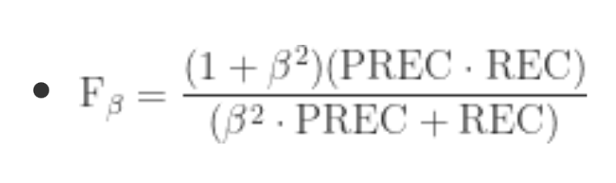
F-score
In practice, when we try to increase the precision of our model, the recall goes down, and vice-versa.
The F1-score captures both the trends in a single value.
F1-score is a harmonic mean of Precision and Recall, and so it gives a combined idea about these two metrics.
It is maximum when Precision is equal to Recall.

Slide 16
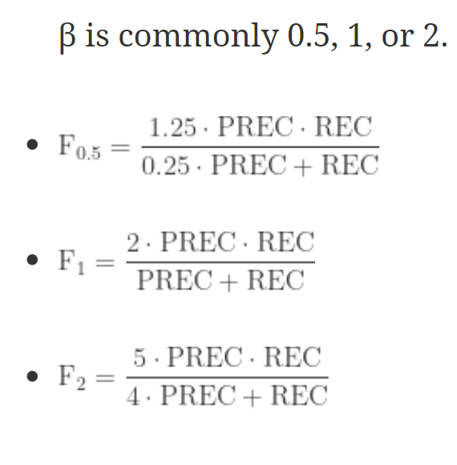
F-score(cont)
Gives more weight to precision
Provides a balance between
precision and recall
Gives more weight to recall
Notes:
But there is a catch here. The interpretability of the F1-score is poor. This means that we don’t know what our classifier is maximizing – precision or recall? So, we use it in combination with other evaluation metrics which gives us a complete picture of the result.

Slide 17
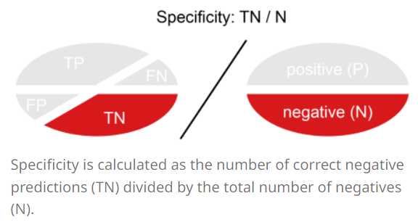
Specificity (True negative rate)
Specificity (SP) is calculated as the number of correct negative predictions divided by the total number of negatives.
It is also called true negative rate (TNR).
The best specificity is 1.0, whereas the worst is 0.0.

Slide 18

Specificity (True negative rate)
The specificity would be calculated by the following formula
Total
60
SP=930/960 = 0.96
940
Total
40
960
1000

Slide 19
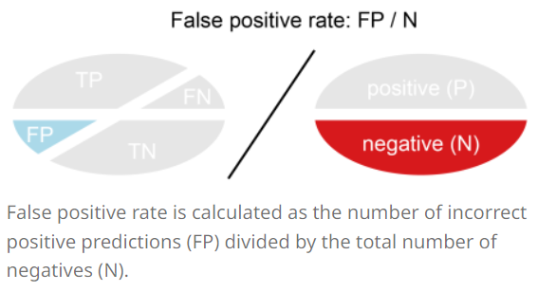
False positive rate
False positive rate (FPR) is calculated as the number of incorrect positive predictions divided by the total number of negatives.
The best false positive rate is 0.0 whereas the worst is 1.0.
It can also be calculated as 1 – specificity.

Slide 20

False positive rate
The specificity would be calculated by the following formula
Total
60
FPR=30/960 = 0.031
940
Total
40
960
1000
Notes:
A higher TNR and a lower FPR is desirable since we want to correctly classify the negative class.

Slide 21
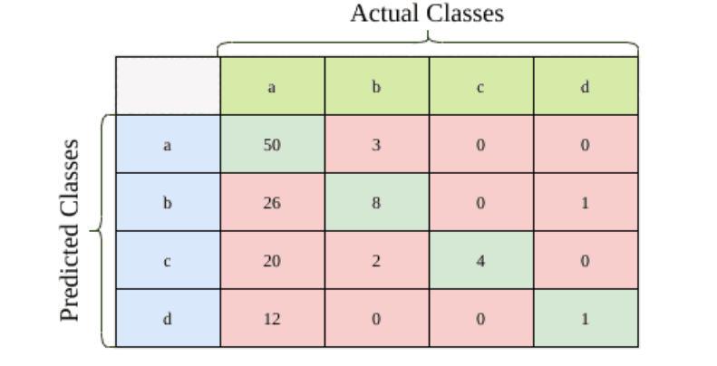
multi-class classification problem
As an illustration, let’s consider the confusion matrix below with a total of 127 samples:

Slide 22

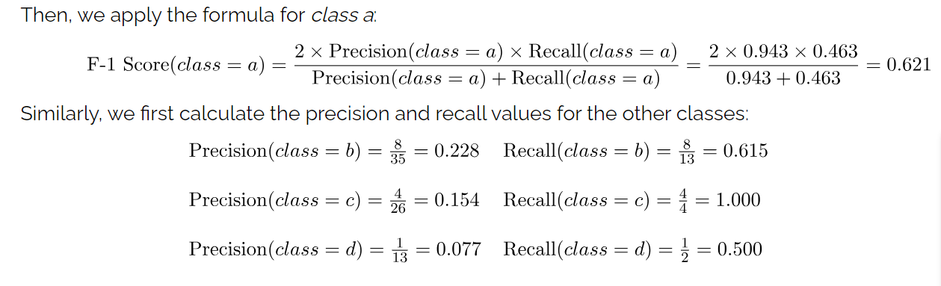

Slide 23
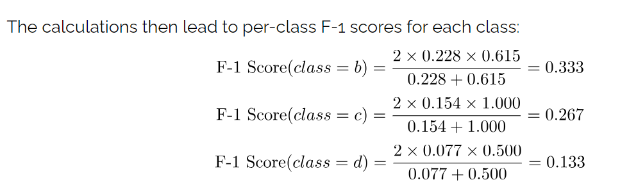

Slide 24
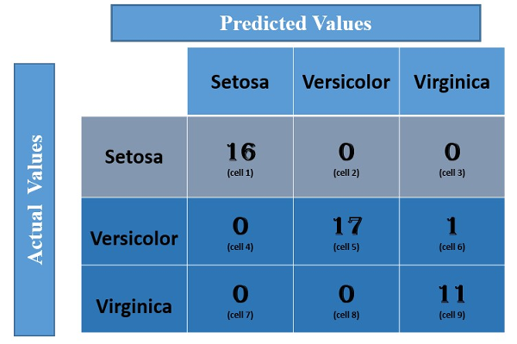
Activity

Slide 25
Test and train Split
An important decision when developing any machine learning model is how to evaluate its final performance
To get an unbiased estimate of the model’s performance, we need to evaluate it on the data we didn’t use for training.
The simplest way to split the data is to use the train-test split method.
It randomly partitions the dataset into two subsets (called training and test sets) so that the predefined percentage of the entire dataset is in the training set.
Then, we train our machine learning model on the training set and evaluate its performance on the test set. In this way, we are always sure that the samples used for training are not used for evaluation and vice versa.
Usually, we use 80/20 split.

Slide 26
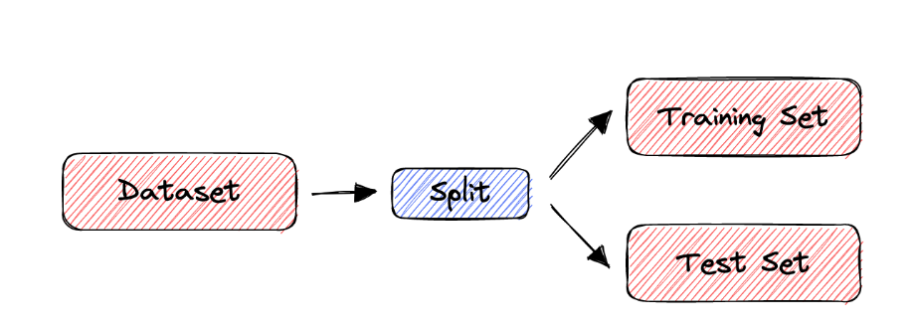
Test and train Split

Slide 27
Cross Validation
The train-split method has certain limitations. When the dataset is small, the method is prone to high variance.
To deal with this issue, we use cross-validation to evaluate the performance of a machine-learning model.
In cross-validation, we don’t divide the dataset into training and test sets only once.
Instead, we repeatedly partition the dataset into smaller groups and then average the performance in each group. That way, we reduce the impact of partition randomness on the results.
Notes:
However, the train-split method has certain limitations. When the dataset is small, the method is prone to high variance. Due to the random partition, the results can be entirely different for different test sets. Why? Because in some partitions, samples that are easy to classify get into the test set, while in others, the test set receives the ‘difficult’ ones.

Slide 28
K-Fold CROSS VALIDATION METHOD
“k-fold Cross-Validation” (e.g., k=10)
randomly partition our full data set into k disjoint subsets (each roughly of size n/k, n = total number of training data points)
for i = 1:10 (here k = 10)
train on 90% of data,
Acc(i) = accuracy on other 10%
end
Cross-Validation-Accuracy = 1/k Σ_{i} Acc(i)
choose the method with the highest cross-validation accuracy
common values for k are 5 and 10
Can also do “leave-one-out” where k = n

Slide 29
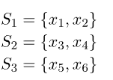

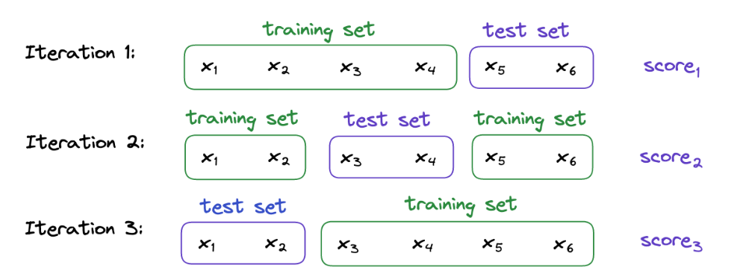
Notes:
For example, let’s suppose that we have a dataset containing 6 samples and that we want to perform a 3-fold cross-validation.
First, we divide into 3 subsets randomly. For instance:
Then, we train and evaluate our machine-learning model 3 times. Each time, two subsets form the training set, while the remaining one acts as the test set. In our example:

Slide 30
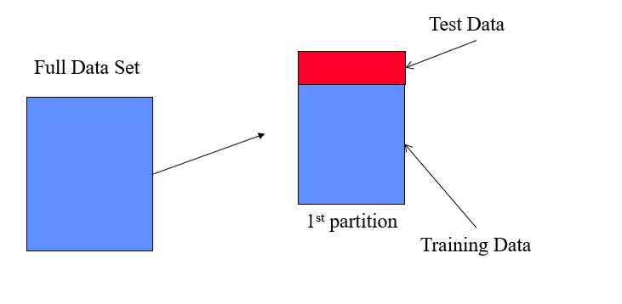

Slide 31
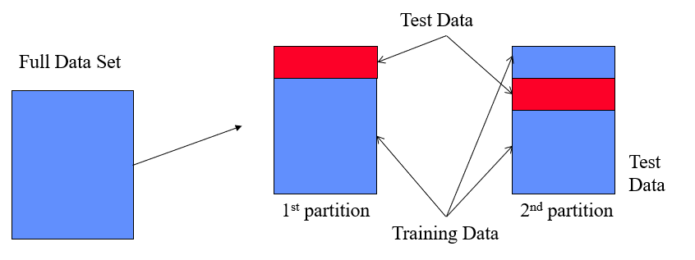

Slide 32
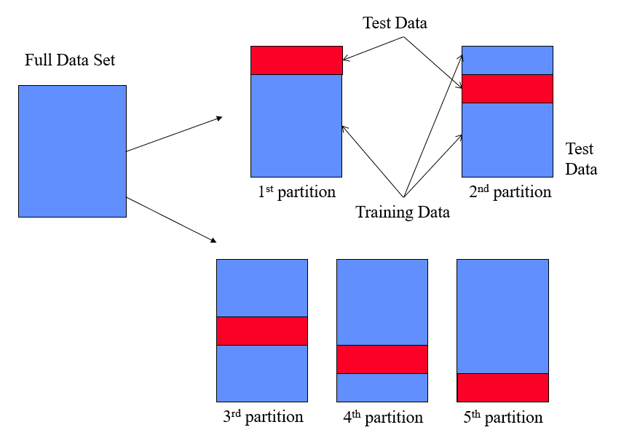

Slide 33
Leave-one-out method
Leave-one-out cross-validation, or LOOCV, is a configuration of k-fold cross-validation where k is set to the number of examples in the dataset.
Each time, only one sample is used as a test set while the rest are used to train our model.
LOOCV is an extreme version of k-fold cross-validation that has the maximum computational cost. It requires one model to be created and evaluated for each example in the training dataset.
Given the computational cost, LOOCV is not appropriate for very large datasets such as more than tens or hundreds of thousands of examples

Slide 34
